Slide 1
Activity selection
Greedy basics

Slide 2



What is activity selection problem…
Given many tasks with a limited resource and considering everything to be mutually exclusive… what is the optimum solution to distribute the task?

Slide 3
How to come up with “THIS” greedy approach?
Consider the following 3 activities:
start[] = {10, 12, 20};
finish[] = {20, 25, 30};

Slide 4
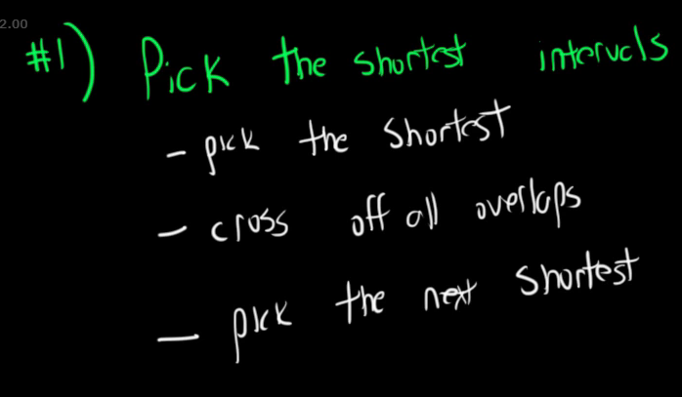
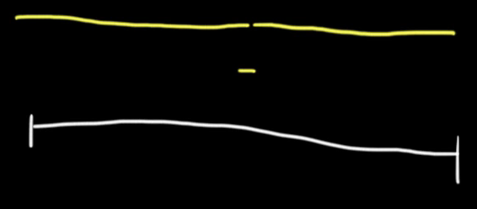
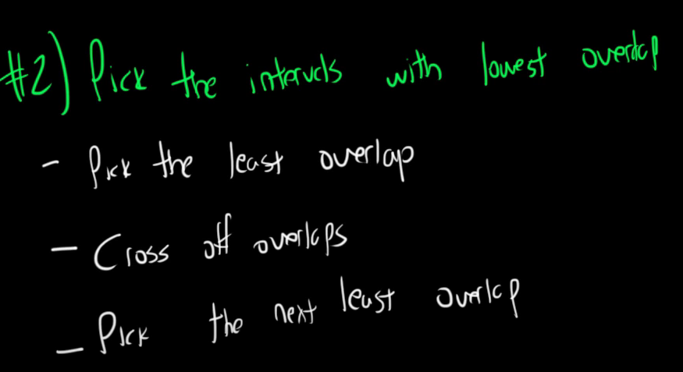
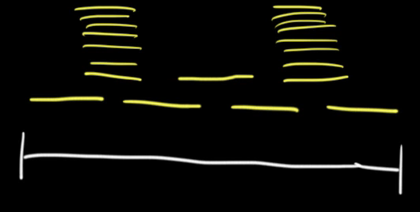

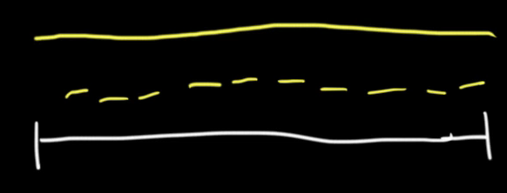


If we are able to disprove even one example of a logic then it is not worth coding it:

Slide 5
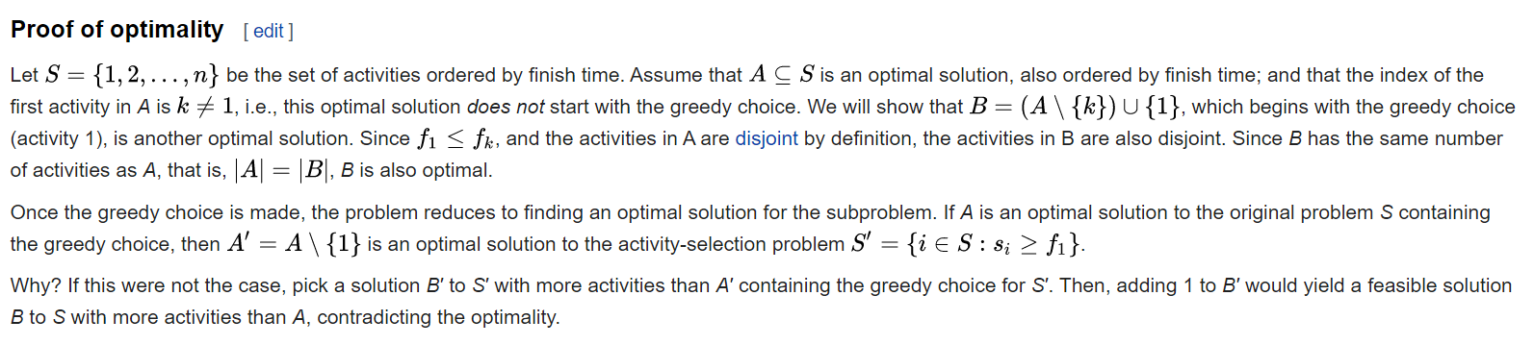
How to prove that greedy is always optimum for this situation:
Meaning: Only Allah can tell you

Slide 6
Now you know what to do, try to now go and do it… (You know logic, try implement)
N meetings in one room | Practice | GeeksforGeeks
Minimum Number of Arrows to Burst Balloons – LeetCode
Minimum Number of Taps to Open to Water a Garden – LeetCode
(then lets look at how the algorithm solves the challenges you faced while trying to implement it)

Slide 7
Algo (in my name)
Def greedy(start,end):
#sort the tasks by end
#first index always selected
k = index of previous selected task’s end = 0
for i in range(1, n):
if task[next_start] > task[prev_end_K]:
#this item is your mutually exclusive item
#Add this to list, count or whatever
Index of prev_k = index of new task
return WHATEVER

Slide 8
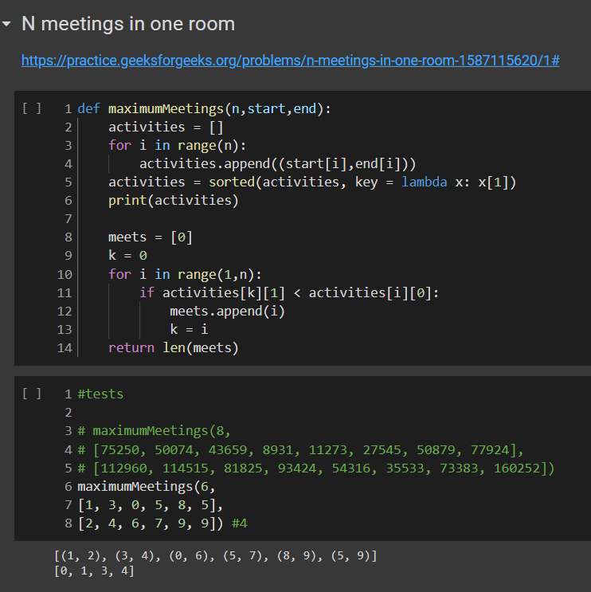
Implement

Slide 9
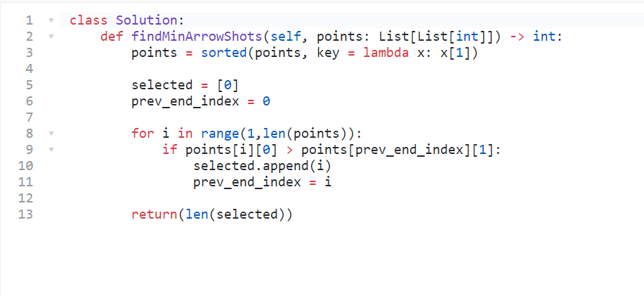
Implement

